Slide 1
Microsoft Teams User Group Berlin
2. März 2023
Meetup #23

Slide 2

Danke!

Slide 3
Agenda
18:00 - 18:15 | Landing Zone
18:15 - 19:15 | Talk 1 – Teams Meetings Aufzeichnen - Richtlinien, Zuweisung & Automatisierung Erik Vettters
19:15 - 19:45 | Microsoft Teams Neuigkeiten Thomas Stensitzki (@stensitzki)
19:45 - ? | Fragen und Antworten rund um Microsoft Teams Organisatorisches
Dieses Meeting wird aufgezeichnet und online auf YoutTube bereitgestellt. This meeting will be recorded and made available online.

Slide 4
Teams Meetings Aufzeichnen - Richtlinien, Zuweisung & Automatisierung
Erik Vettters

Slide 6
Neues in Microsoft Teams Ankündigungen & Rollouts
Updates
Meetup #23 Thomas Stensitzki

Slide 7
Neuigkeiten in Microsoft Teams
Pronouns on Profile Cards in Microsoft Teams and Outlook Web Weitere Informationen | Admin Informationen
Wiki retirement and the future of note taking in Teams Channels Weitere Informationen
Teams Help App Pops Out by Default
App Support In Channel Meetings
Join Meetings from Calendar View on Apple CarPlay
Ultrasound Howling Detection in Teams Meetings
Microsoft Teams: Automatic lowering of a user's Raised Hand after speaking

Slide 8
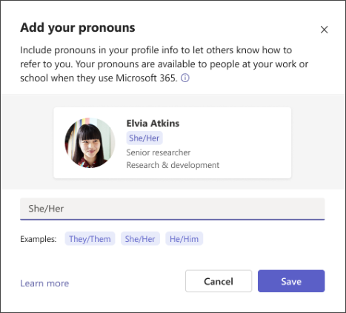
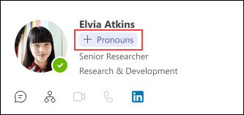
Pronouns on Profile Cards in Microsoft Teams and Outlook Web
Notes:
Off by Default

Slide 9
Neuigkeiten in Microsoft Teams
Pronouns on Profile Cards in Microsoft Teams and Outlook Web Weitere Informationen | Admin Informationen
Wiki retirement and the future of note taking in Teams Channels Weitere Informationen
Teams Help App Pops Out by Default
App Support In Channel Meetings
Join Meetings from Calendar View on Apple CarPlay
Ultrasound Howling Detection in Teams Meetings
Microsoft Teams: Automatic lowering of a user's Raised Hand after speaking

Slide 10
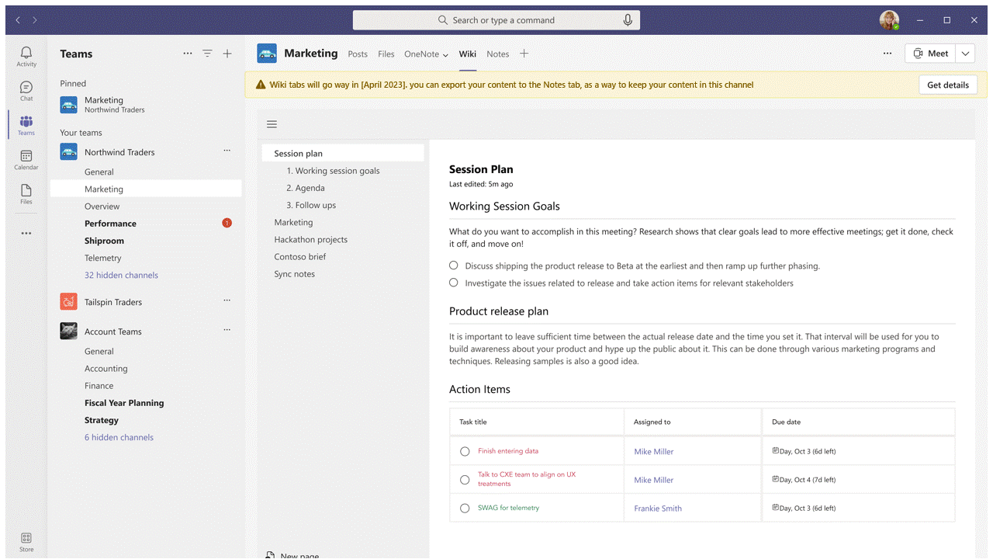
Wiki retirement and the future of note taking in Teams Channels
Neues "Notizen"-Tab für neue Kanäle
Wiki-Ablösung
März 2023
Es können keine neuen Wikis mehr erstellt werden
Möglichkeit eines Exports zu OneNote
Nach dem Export ist das Wiki im Nur-Lesen-Modus
Mitte 2023
Wiki-Tab wird offiziell nicht mehr unterstützt
Lesender und schreibender Wiki-Zugriff per Wiki-App
Export wird weiter unterstützt
Januar 2024
Wiki-Tab und Wiki-App sind nicht mehr verfügbar
Download der Wiki-Dateien via SharePoint

Slide 11
Neuigkeiten in Microsoft Teams
Pronouns on Profile Cards in Microsoft Teams and Outlook Web Weitere Informationen | Admin Informationen
Wiki retirement and the future of note taking in Teams Channels Weitere Informationen
Teams Help App Pops Out by Default
App Support In Channel Meetings
Join Meetings from Calendar View on Apple CarPlay
Ultrasound Howling Detection in Teams Meetings
Microsoft Teams: Automatic lowering of a user's Raised Hand after speaking

Slide 12
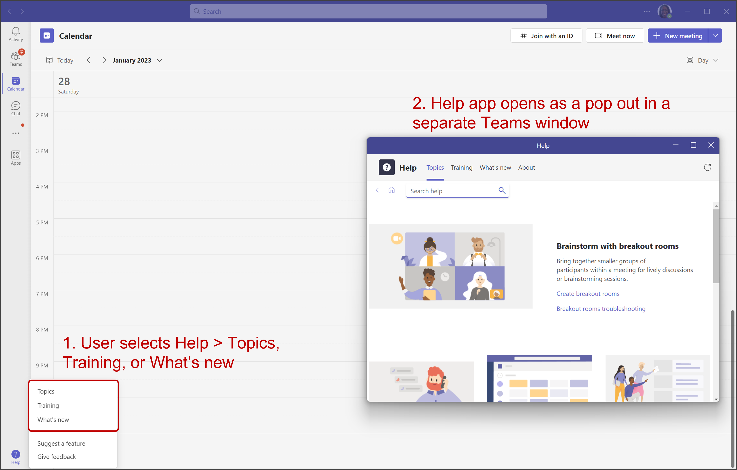
Teams Help App Pops Out by Default

Slide 13
Neuigkeiten in Microsoft Teams
Pronouns on Profile Cards in Microsoft Teams and Outlook Web Weitere Informationen | Admin Informationen
Wiki retirement and the future of note taking in Teams Channels Weitere Informationen
Teams Help App Pops Out by Default
App Support In Channel Meetings
Join Meetings from Calendar View on Apple CarPlay
Ultrasound Howling Detection in Teams Meetings
Microsoft Teams: Automatic lowering of a user's Raised Hand after speaking

Slide 14
Neuigkeiten in Microsoft Teams
Pronouns on Profile Cards in Microsoft Teams and Outlook Web Weitere Informationen | Admin Informationen
Wiki retirement and the future of note taking in Teams Channels Weitere Informationen
Teams Help App Pops Out by Default
App Support In Channel Meetings
Join Meetings from Calendar View on Apple CarPlay
Ultrasound Howling Detection in Teams Meetings
Microsoft Teams: Automatic lowering of a user's Raised Hand after speaking

Slide 15
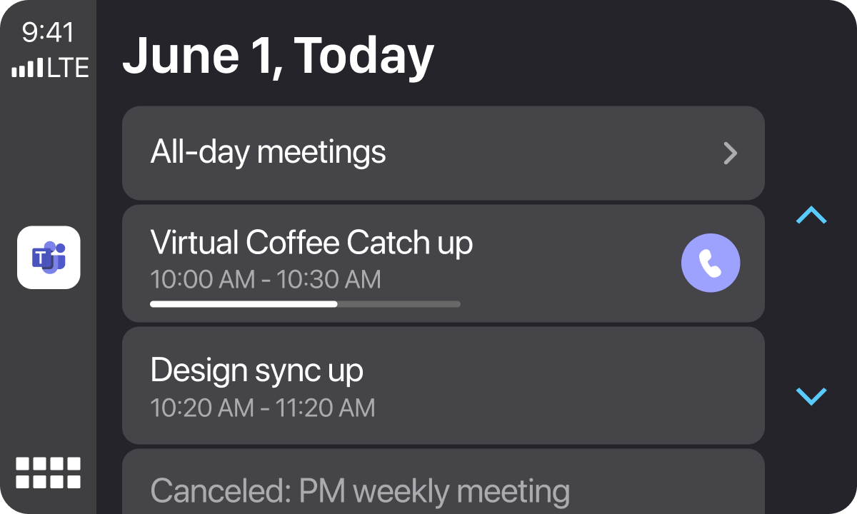
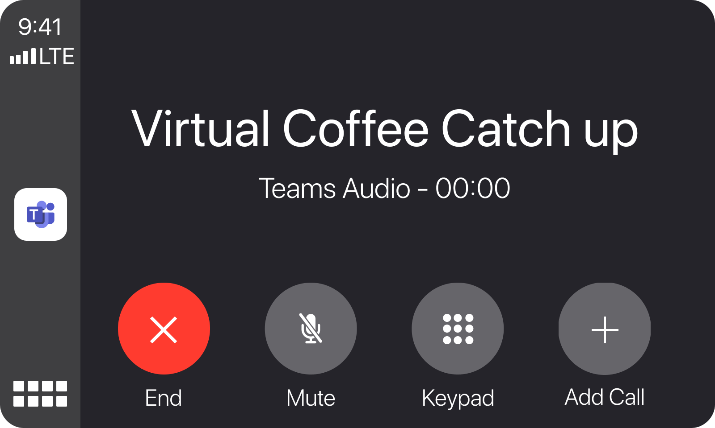
Join Meetings from Calendar View on Apple CarPlay

Slide 16
Neuigkeiten in Microsoft Teams
Pronouns on Profile Cards in Microsoft Teams and Outlook Web Weitere Informationen | Admin Informationen
Wiki retirement and the future of note taking in Teams Channels Weitere Informationen
Teams Help App Pops Out by Default
App Support In Channel Meetings
Join Meetings from Calendar View on Apple CarPlay
Ultrasound Howling Detection in Teams Meetings
Microsoft Teams: Automatic lowering of a user's Raised Hand after speaking

Slide 17
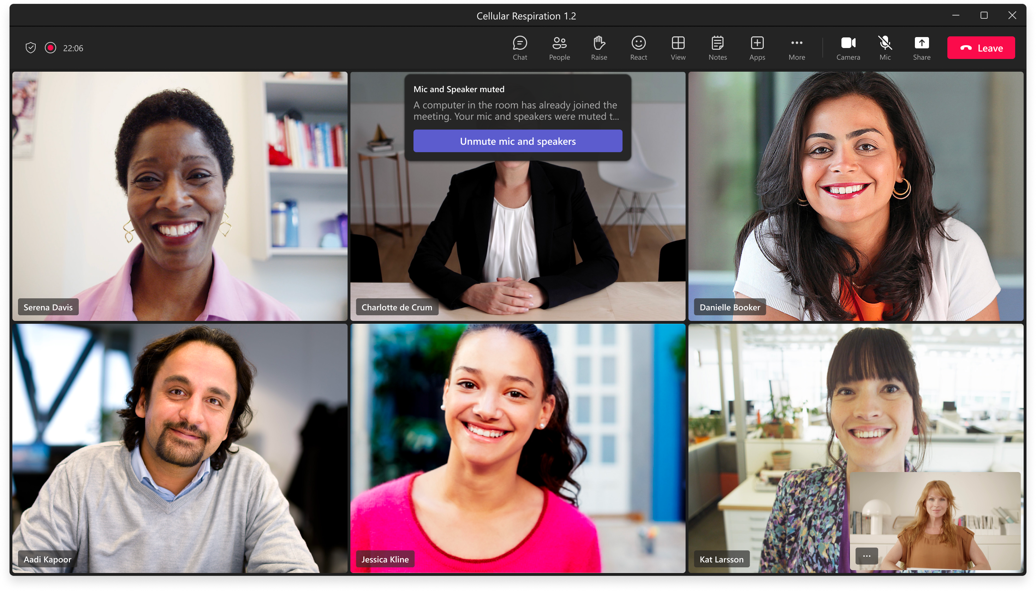
Ultrasound Howling Detection in Teams Meetings

Slide 18
Neuigkeiten in Microsoft Teams
Pronouns on Profile Cards in Microsoft Teams and Outlook Web Weitere Informationen | Admin Informationen
Wiki retirement and the future of note taking in Teams Channels Weitere Informationen
Teams Help App Pops Out by Default
App Support In Channel Meetings
Join Meetings from Calendar View on Apple CarPlay
Ultrasound Howling Detection in Teams Meetings
Microsoft Teams: Automatic lowering of a user's Raised Hand after speaking

Slide 19
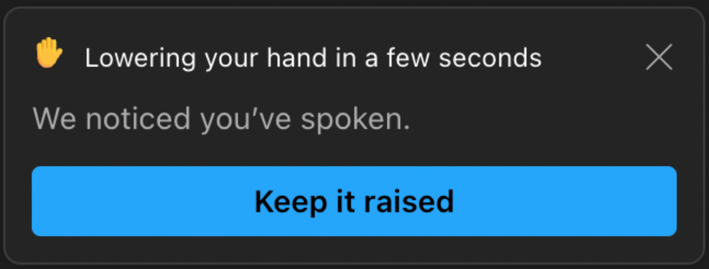
Microsoft Teams: Automatic lowering of a user's Raised Hand after speaking

Slide 20
Neues in Microsoft Teams Ankündigungen & Rollouts für Admins
Updates
Meetup #23 Thomas Stensitzki

Slide 21
Neuigkeiten in Microsoft Teams für Admins
PowerPoint Live in Teams: Magnify Slide
Microsoft Teams Rooms on Windows store application 4.16 update Weitere Informationen
The Room Remote feature for desktop
Enabling New Call Controls with Survivable Branch Appliance Weitere Informationen
'Forms' app polling features for Teams meeting will be replaced by 'Polls' app Weitere Informationen
Suggested Files in 1:1 Chats

Slide 22
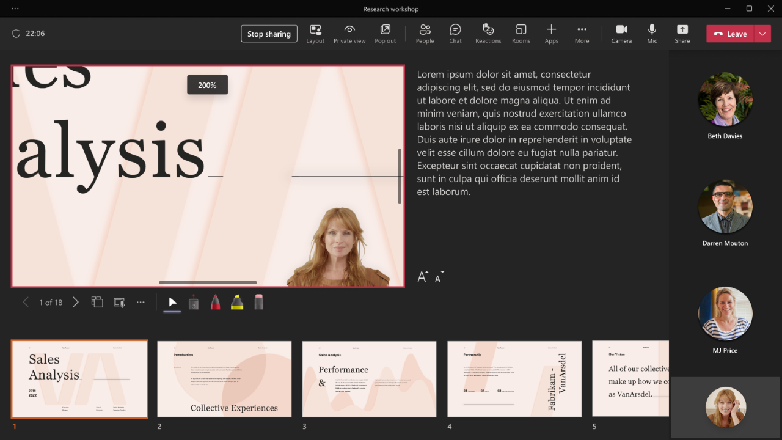
PowerPoint Live in Teams: Magnify Slide
Notes:
Use the +/- buttons in the (…) menu
Use Plus or Minus keys or Shift + Plus or Shift + Minus key on the keyboard (Ensure keyboard focus is on the PowerPoint Live slideshow area)
Pinch or stretch on the track pad while hovering over the slide
Pinch or stretch on the slide using a touch screen enabled device
Use Ctrl + mouse wheel scroll while hovering over the slide

Slide 23
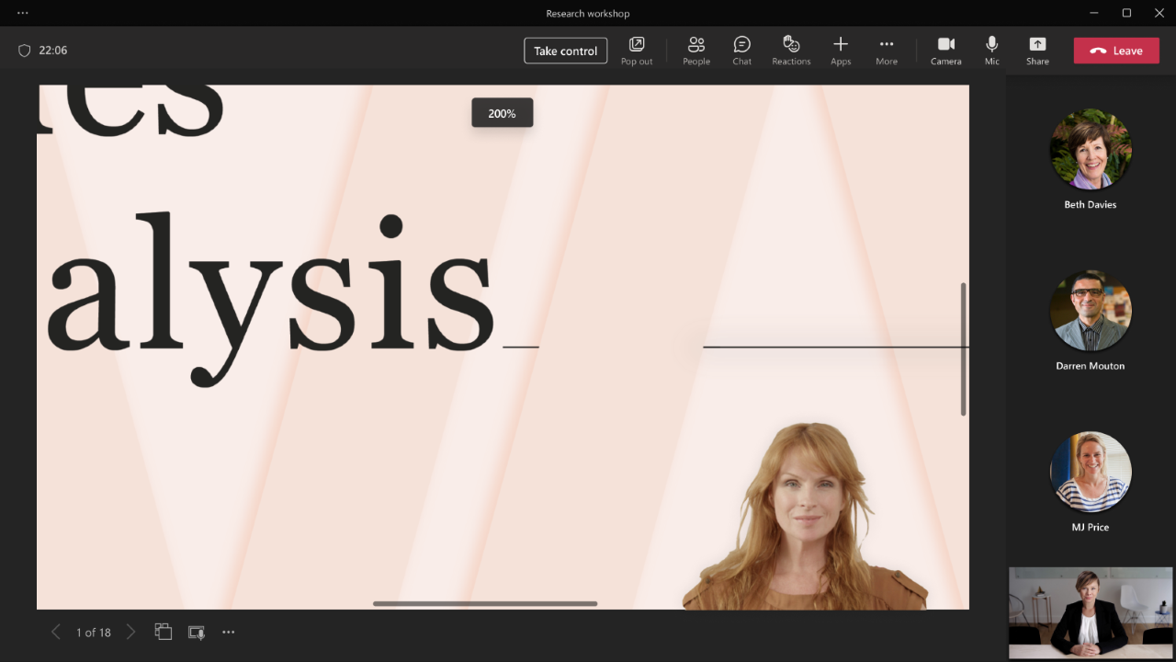
PowerPoint Live in Teams: Magnify Slide

Slide 24
Neuigkeiten in Microsoft Teams für Admins
PowerPoint Live in Teams: Magnify Slide
Microsoft Teams Rooms on Windows store application 4.16 update Weitere Informationen
The Room Remote feature for desktop
Enabling New Call Controls with Survivable Branch Appliance Weitere Informationen
'Forms' app polling features for Teams meeting will be replaced by 'Polls' app Weitere Informationen
Suggested Files in 1:1 Chats

Slide 25
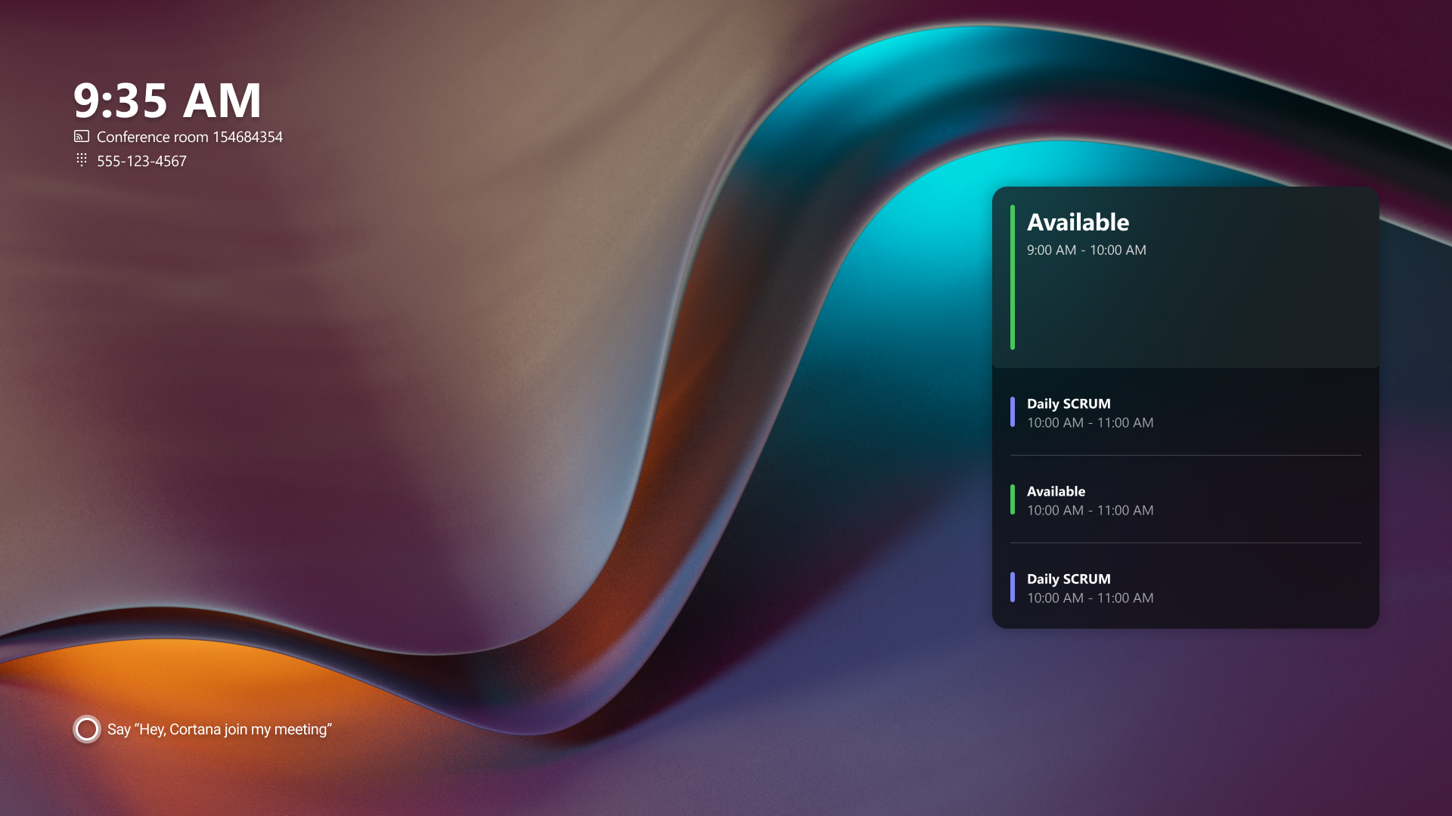
Microsoft Teams Rooms on Windows store application 4.16 update

Slide 26
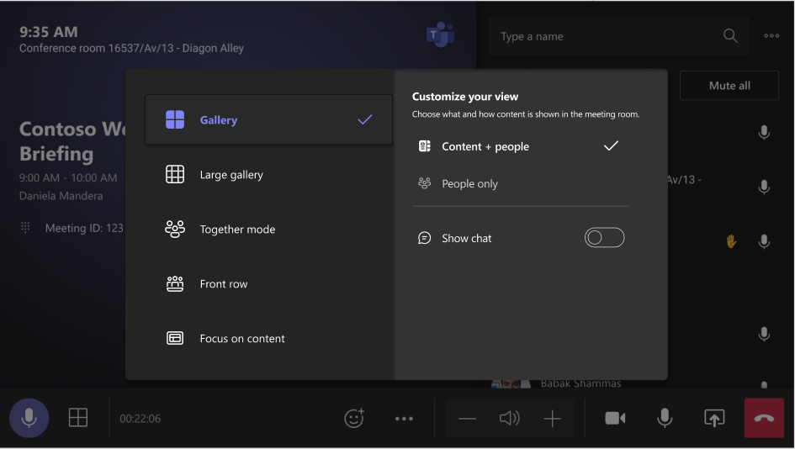
Microsoft Teams Rooms on Windows store application 4.16 update

Slide 27

Microsoft Teams Rooms on Windows store application 4.16 update – Premium Features
Notes:
Watermark, End-to-end Encryption for meetings, and Sensitivity labels

Slide 28
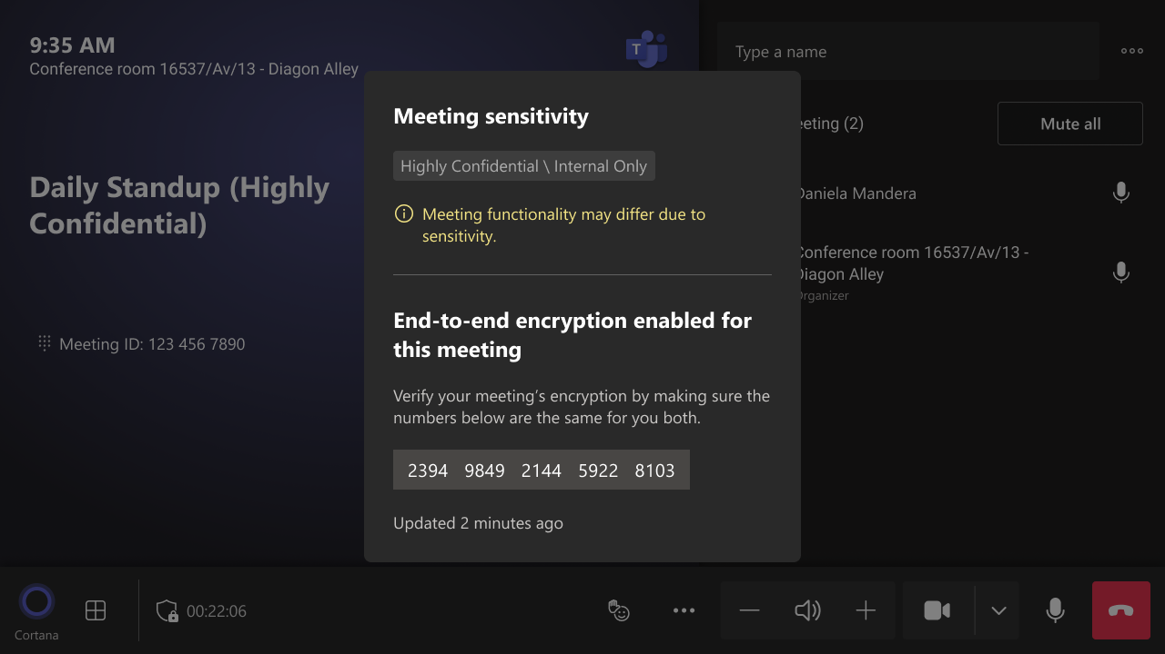
Microsoft Teams Rooms on Windows store application 4.16 update – Premium Features
Notes:
Watermark, End-to-end Encryption for meetings, and Sensitivity labels

Slide 29
Neuigkeiten in Microsoft Teams für Admins
PowerPoint Live in Teams: Magnify Slide
Microsoft Teams Rooms on Windows store application 4.16 update Weitere Informationen
The Room Remote feature for desktop
Enabling New Call Controls with Survivable Branch Appliance Weitere Informationen
'Forms' app polling features for Teams meeting will be replaced by 'Polls' app Weitere Informationen
Suggested Files in 1:1 Chats

Slide 30
Neuigkeiten in Microsoft Teams für Admins
PowerPoint Live in Teams: Magnify Slide
Microsoft Teams Rooms on Windows store application 4.16 update Weitere Informationen
The Room Remote feature for desktop
Enabling New Call Controls with Survivable Branch Appliance Weitere Informationen
'Forms' app polling features for Teams meeting will be replaced by 'Polls' app Weitere Informationen
Suggested Files in 1:1 Chats

Slide 31
Neuigkeiten in Microsoft Teams für Admins
PowerPoint Live in Teams: Magnify Slide
Microsoft Teams Rooms on Windows store application 4.16 update Weitere Informationen
The Room Remote feature for desktop
Enabling New Call Controls with Survivable Branch Appliance Weitere Informationen
'Forms' app polling features for Teams meeting will be replaced by 'Polls' app Weitere Informationen
Suggested Files in 1:1 Chats

Slide 32
Neuigkeiten in Microsoft Teams für Admins
PowerPoint Live in Teams: Magnify Slide
Microsoft Teams Rooms on Windows store application 4.16 update Weitere Informationen
The Room Remote feature for desktop
Enabling New Call Controls with Survivable Branch Appliance Weitere Informationen
'Forms' app polling features for Teams meeting will be replaced by 'Polls' app Weitere Informationen
Suggested Files in 1:1 Chats

Slide 33
Suggested Files in 1:1 Chats
Standardmäßig aktiviert
"Datei teilen" wird angezeigt, sobald der Chat "erkennt", dass man eine Datei senden möchte
Bestandteil der Funktion "Vorgeschlagene Antworten"
Konfiguration per Nachrichtenrichtlinie oder Benutzereinstellungen

Slide 34
Neuigkeiten in Microsoft Teams für Admins
Graph API for Teams Meetings Transcripts Weitere Informationen
Insights about people in profile cards now coming to Microsoft Teams Weitere Informationen
Introducing the Simplified Left Navigation Feature in Teams Admin Center
Video Closed Caption in PowerPoint Live
Microsoft Teams Rooms Licensing Support in Teams admin center Weitere Informationen
Export feature in Teams Admin Center

Slide 35
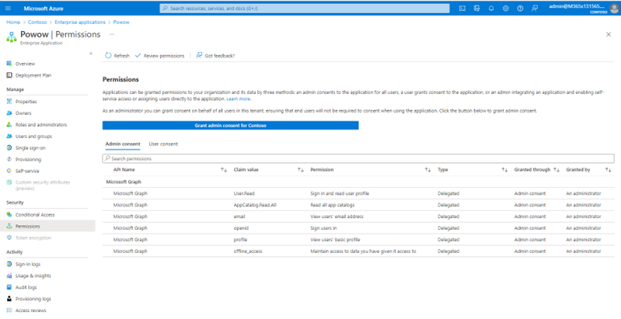
Graph API for Teams Meetings Transcripts

Slide 36
Neuigkeiten in Microsoft Teams für Admins
Graph API for Teams Meetings Transcripts Weitere Informationen
Insights about people in profile cards now coming to Microsoft Teams Weitere Informationen
Introducing the Simplified Left Navigation Feature in Teams Admin Center
Video Closed Caption in PowerPoint Live
Microsoft Teams Rooms Licensing Support in Teams admin center Weitere Informationen
Export feature in Teams Admin Center

Slide 37
Neuigkeiten in Microsoft Teams für Admins
Graph API for Teams Meetings Transcripts Weitere Informationen
Insights about people in profile cards now coming to Microsoft Teams Weitere Informationen
Introducing the Simplified Left Navigation Feature in Teams Admin Center
Video Closed Caption in PowerPoint Live
Microsoft Teams Rooms Licensing Support in Teams admin center Weitere Informationen
Export feature in Teams Admin Center

Slide 38
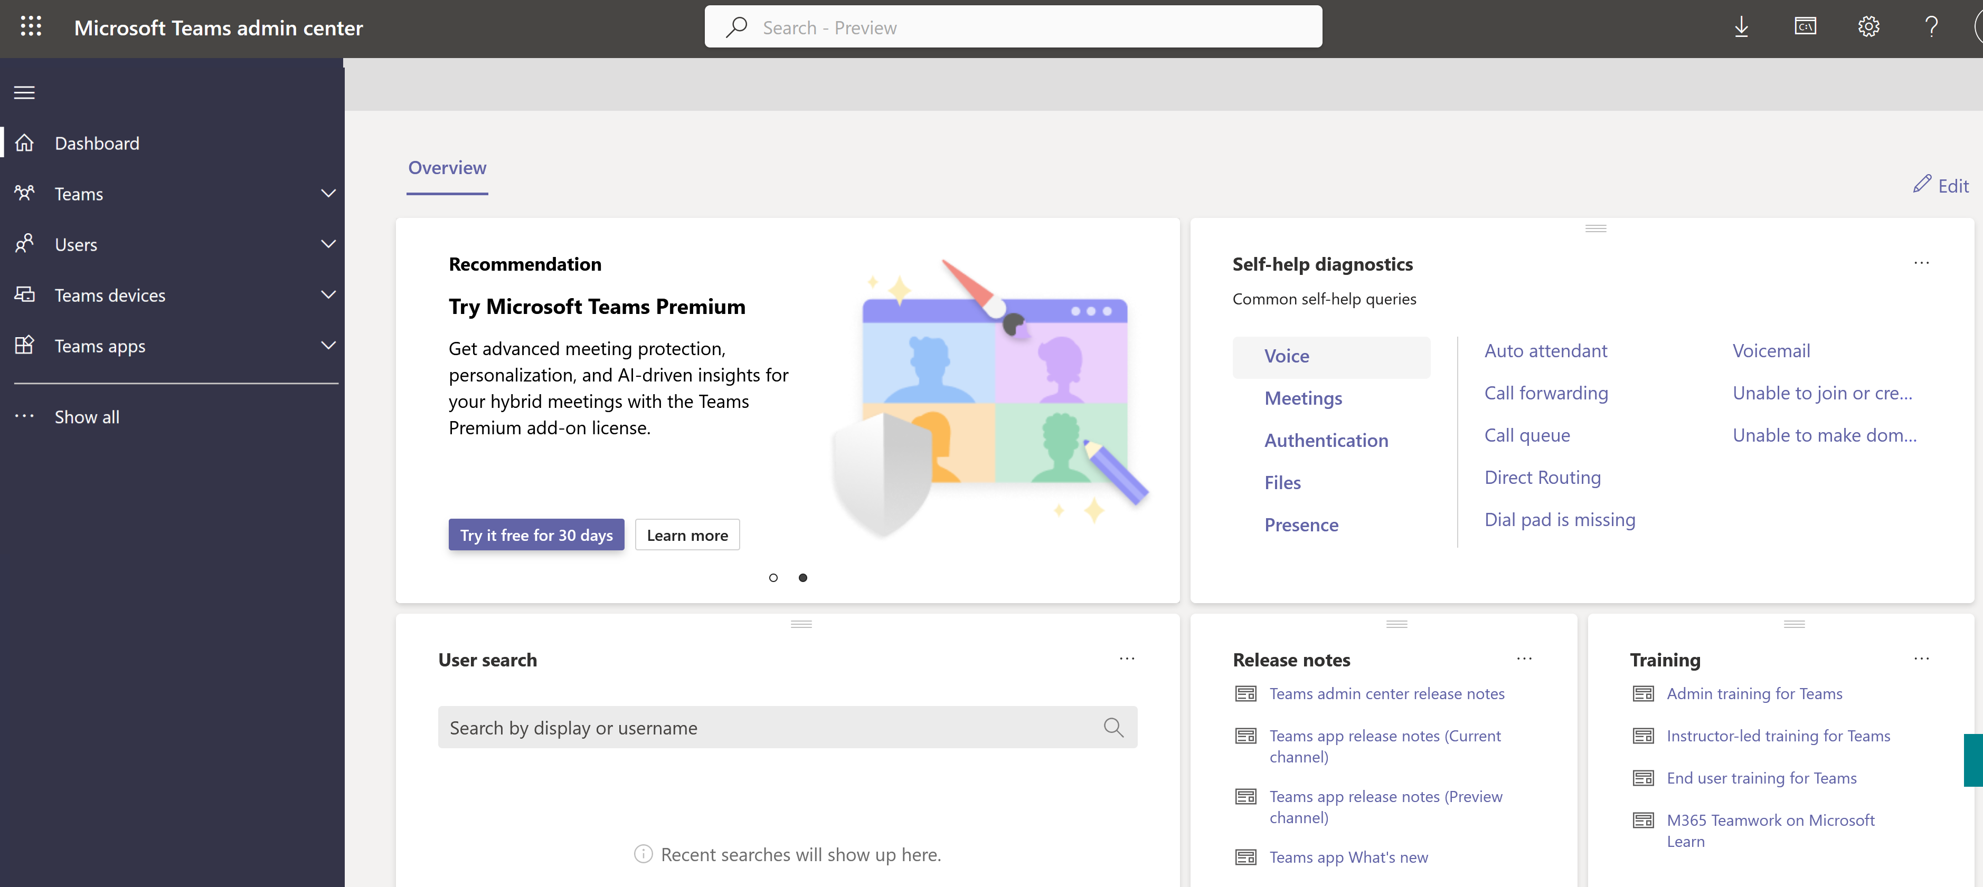
Introducing the Simplified Left Navigation Feature in Teams Admin Center

Slide 39
Neuigkeiten in Microsoft Teams für Admins
Graph API for Teams Meetings Transcripts Weitere Informationen
Insights about people in profile cards now coming to Microsoft Teams Weitere Informationen
Introducing the Simplified Left Navigation Feature in Teams Admin Center
Video Closed Caption in PowerPoint Live
Microsoft Teams Rooms Licensing Support in Teams admin center Weitere Informationen
Export feature in Teams Admin Center

Slide 40
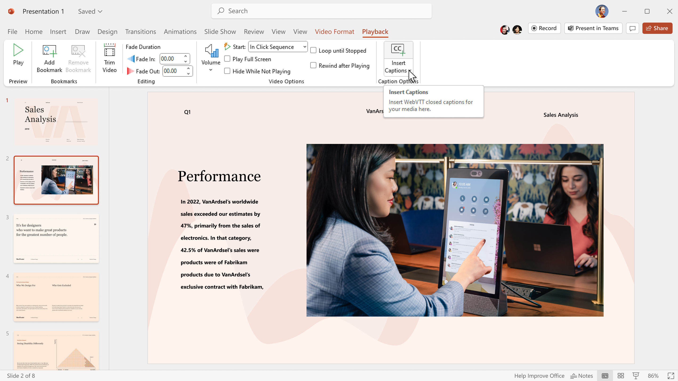
Video Closed Caption in PowerPoint Live

Slide 41
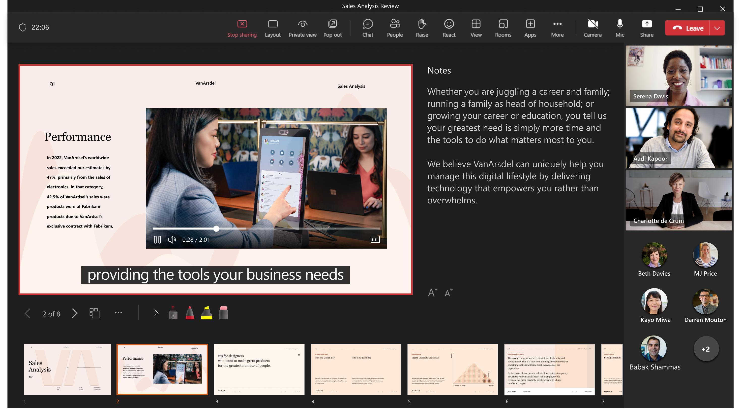
Video Closed Caption in PowerPoint Live

Slide 42
Neuigkeiten in Microsoft Teams für Admins
Graph API for Teams Meetings Transcripts Weitere Informationen
Insights about people in profile cards now coming to Microsoft Teams Weitere Informationen
Introducing the Simplified Left Navigation Feature in Teams Admin Center
Video Closed Caption in PowerPoint Live
Microsoft Teams Rooms Licensing Support in Teams admin center Weitere Informationen
Export feature in Teams Admin Center

Slide 43
Neuigkeiten in Microsoft Teams für Admins
Graph API for Teams Meetings Transcripts Weitere Informationen
Insights about people in profile cards now coming to Microsoft Teams Weitere Informationen
Introducing the Simplified Left Navigation Feature in Teams Admin Center
Video Closed Caption in PowerPoint Live
Microsoft Teams Rooms Licensing Support in Teams admin center Weitere Informationen
Export feature in Teams Admin Center

Slide 44
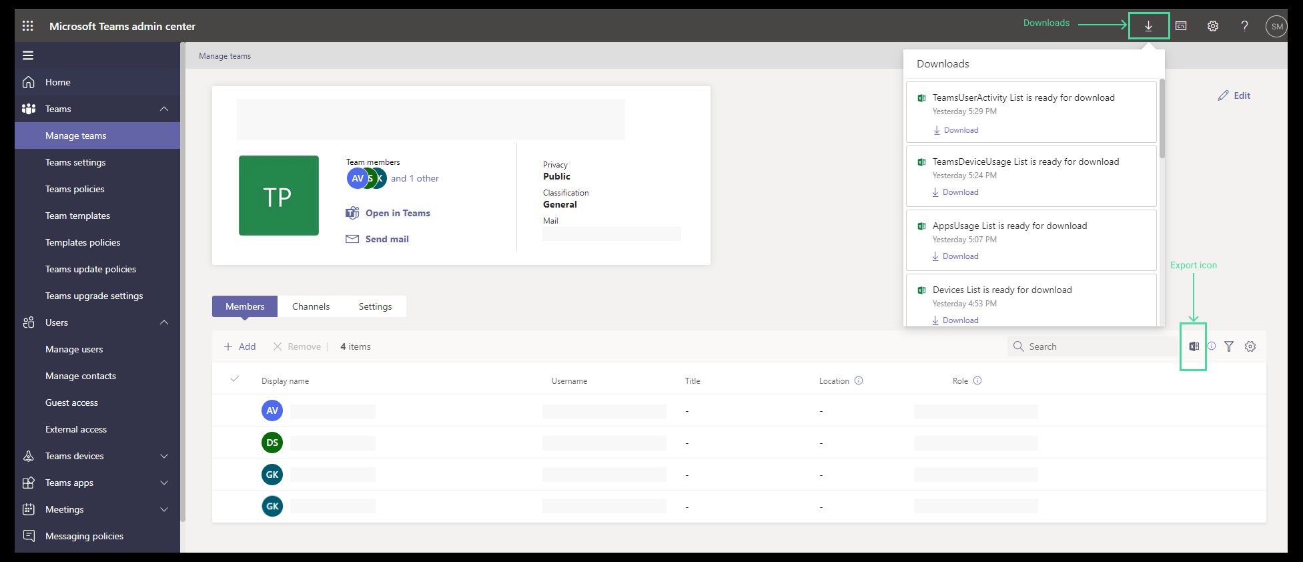
Export feature in Teams Admin Center

Slide 45
Microsoft Teams – Links
What’s New in Microsoft Teams | January 2023
What’s New in Microsoft Teams | February 2023
What’s New in Microsoft Teams for Education | January 2023
What’s New in Microsoft Teams for Education | February 2023
Microsoft Teams Blog
Microsoft Teams Community Blog
Microsoft Teams Feedback Portal

Slide 46
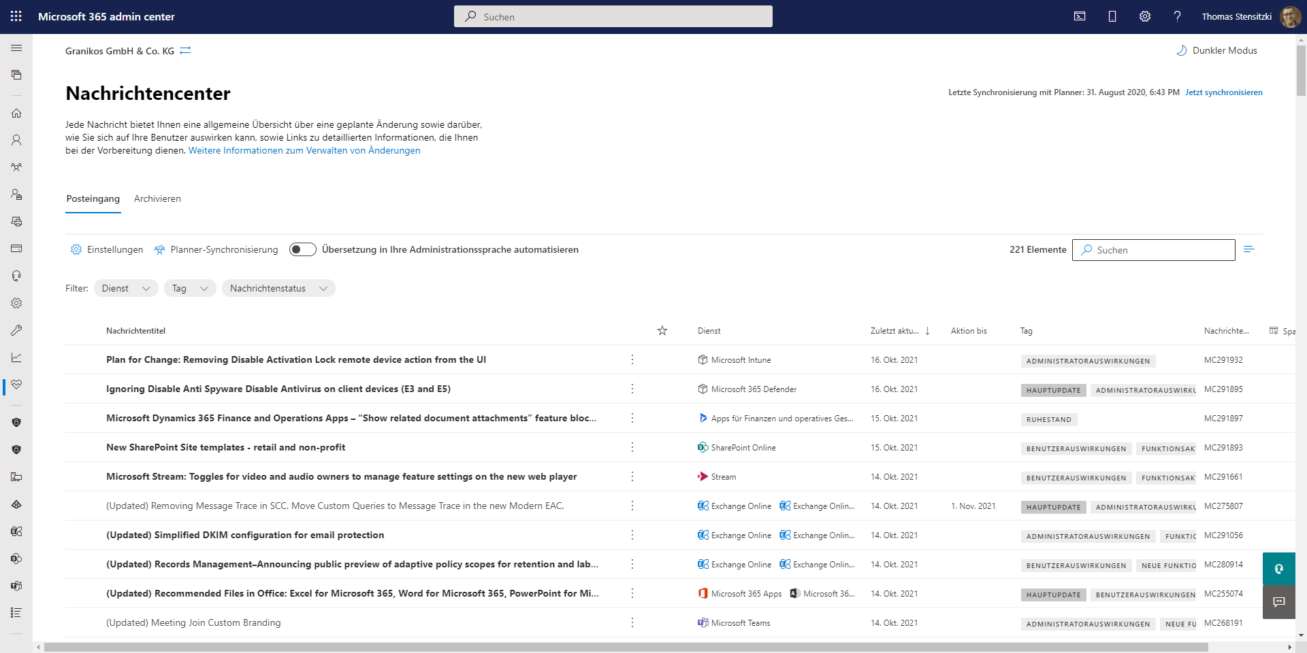
https://admin.microsoft.com/#/MessageCenter

Slide 47
Organisatorisches

Slide 48
Veranstaltungen
Datum
2. März 2023 | Teams User Group Berlin – Meetup #23
15. Juni 2023 | aMS Berlin 2023

Slide 49
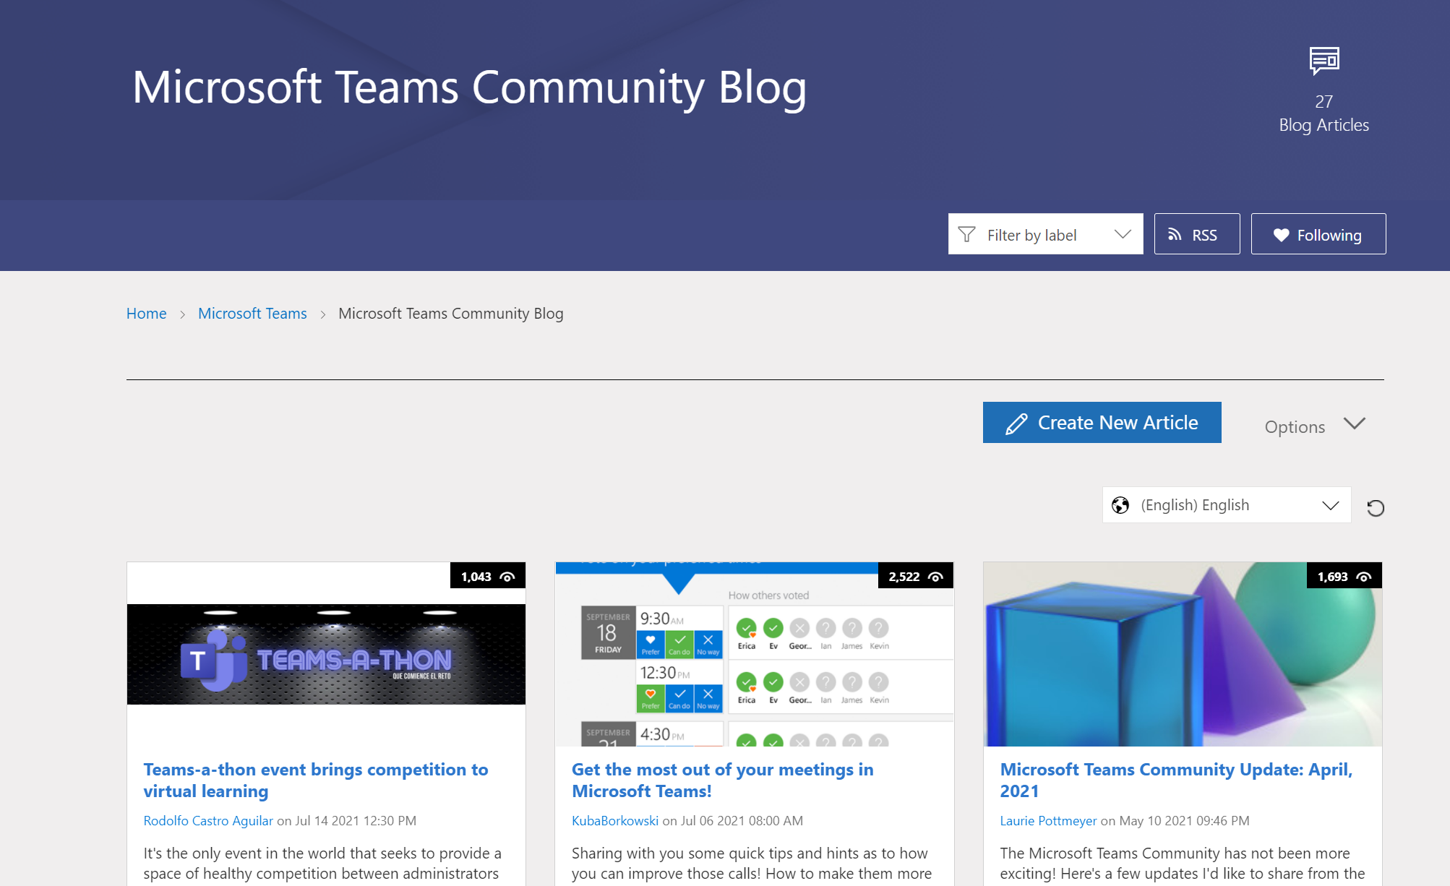
Teams Community Blog
→https://aka.ms/TeamsCommunityBlogger

Slide 50
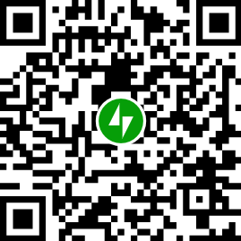
Organisatorisches
Microsoft Community Tenant für User Groups
Teilnahme als Microsoft 365 Gast
Anmeldung: https://go.granikos.eu/TeamsUGForm
Teams Meeting Teilnahme-Link
https://teamsusergroup.berlin/meetup
Teams User Group Aufzeichnungen
https://teamsusergroup.berlin/video

Slide 51
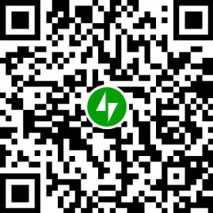
Vielen Dank für eure Teilnahme!
Das nächste Meetup:
→ 25. Mai 2023
https://TeamsUserGroup.Berlin/register
Spread the Word!
#TeamsUGBerlin
Aufzeichnungen unserer Meetups sind im Community Team und bei YouTube verfügbar.

Slide 52
Offene Diskussion

